Slide 1
BİG O NOTATION
TURAL JAFAROV

Slide 2
BIG O NOTATION(BÖYÜK O NOTASIYASI)
ALQORITMIN EFFEKTIVLIYI
BIG O NOTASIYASI- O(N)
O(N^2) O(N!)
Addimlarin sayi
O(LOG2N)
O(N)
O(N*LOGN)

Slide 3
Big o notation bizə alqoritmin nə qədər tez işləməsini göstərir,suretini gostermir Big o establishes a worst-case run time-Big o en pis hali teqdim edir.
.
In general, the worst-case scenario of a Binary Search is Log of n + 1. The Big O notation for Binary Search is O(log N). In contrast to O(N) which takes an additional step for each data element, O(log N) means that the algorithm takes an additional step each time the data doubles.
SIMPLE SEARCH BINARY SEARCH
Çoxlughun 24 elementi olarsa,Big O Notation Choxlughun 24 elementi olsa,Big O Notation 24-O(log2.24)=O(4.5)
Olacaq O(24) 100-O(log2.100)=O(6.6)
24-O(24) 1000-O(log2.1000)=O(9.9)
100-O(100)
1000-O(1000)
Eger elementler sayi 24e beraberdise o zaman 24 addima alqoritm en pis halda tapmis olacaq,En yaxshi halda
Ise binary searchde 4.5 addima tapmis olacaq.

Slide 4
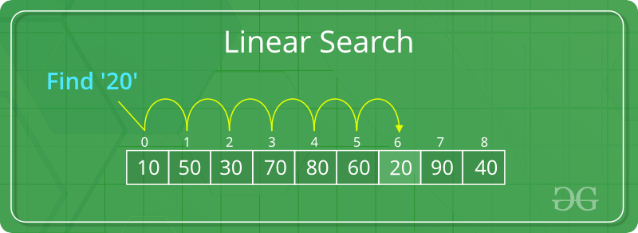
LINEAR SEARCH
Linear search is the simplest method for searching. In Linear search technique of searching; the element to be found in searching the elements to be found is searched sequentially in the list. his method can be performed on a sorted or an unsorted list (usually arrays).

Slide 5
LINEARY SEARCH ALGORİTM
Step 1: First, read the search element (Target element) in the array.(Evvelce massivdeki axtaris elementini oxuyun)
Step 2: In the second step compare the search element with the first element in the array.(2ci addimda axtaris elementini 1ci element ile muqayise edin)
Step 3: If both are matched, display “Target element is found” and terminate the Linear Search function.(Eger her 2si uyghun gelirse
“Hedef Tapildi”yazisini gosterin ve Lineary Search I dayandirin)
Step 4: If both are not matched, compare the search element with the next element in the array.(Eger hec biri uyghun gelmirse massivin novbeti elementini axtaris elementi ile muqayise edin.)
Step 5: In this step, repeat steps 3 and 4 until the search (Target) element is compared with the
last element of the array.(axtarish elementi muqayise olunana qeder step3&&step4u tekrarla)
Step 6 – If the last element in the list does not match, the Linear Search Function will be
terminated, and the message “Element is not found” will be displayed.(Siyahidaki son element uyghun gelmirse axtaris dayanir ve “Element is’nt found yazilacaq.)

Slide 6
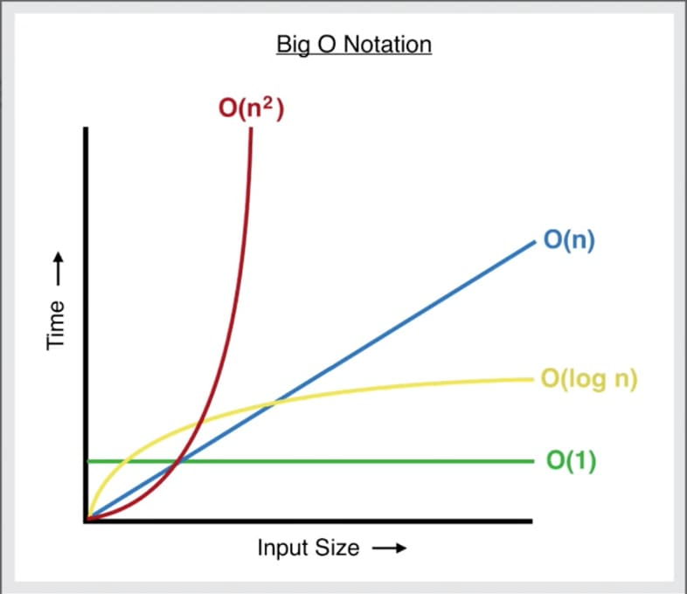
BINARY SEARCH
Binary Search is a searching algorithm used in a sorted array by repeatedly dividing the search interval in half. The idea of binary search is to use the information that the array is sorted and reduce the time complexity to O(Log n).
Input: arr[] = {10, 20, 30, 50, 60, 80, 110, 130, 140, 170}, x = 110 Output: 6 Explanation: Element x is present at index 6.
Input: arr[] = {10, 20, 30, 40, 60, 110, 120, 130, 170}, x = 175 Output: -1 Explanation: Element x is not present in arr[].

Slide 7
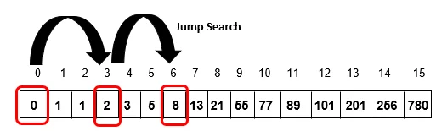
JUMP SEARCH
Given an array of numbers where each element represents the max number of jumps that can be made forward from that element. For each array element, count the number of ways jumps can be made from that element to reach the end of the array. If an element is 0, then a move cannot be made through that element. The element that cannot reach the end should have a count “-1“.(Hər bir elementin həmin elementdən irəlilənə biləcək maksimum tullanma sayını əks etdirən bir sıra rəqəmlər nəzərə alınmaqla. Hər massiv elementi üçün massivin sonuna çatmaq üçün həmin elementdən atlamaların edilə biləcəyi yolların sayını sayın. Element 0-dırsa, bu element vasitəsilə hərəkət edilə bilməz. Sona çata bilməyən elementin sayı “-1” olmalıdır.)
“
static void countWaysToJump(int[] arr, int n)
{
// count_jump[i] store number of ways
// arr[i] can reach to the end
int[] count_jump = new int[n];
for(int i = 0; i < n; i++)
count_jump[i] = 0;
”

Slide 8
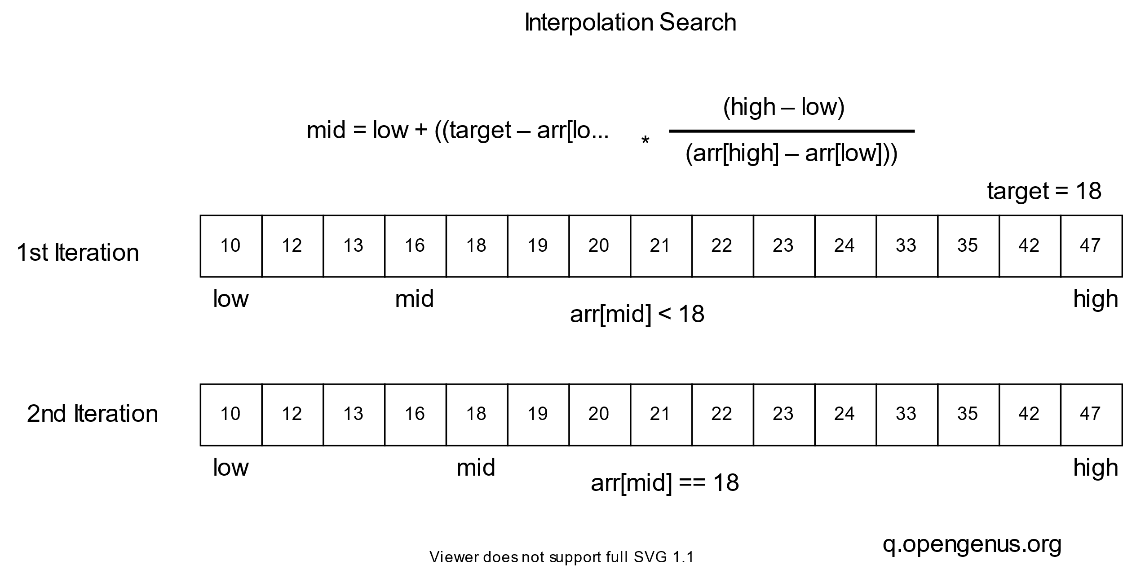
INTERPOLATION SEARCH
Given a sorted array of n uniformly distributed values arr[], write a function to search for a particular element x in the array. (n vahid paylanmış arr[] dəyərlərinin çeşidlənmiş massivini nəzərə alaraq, massivdə xüsusi x elementini axtarmaq üçün funksiya yazın.) The Interpolation Search is an improvement over Binary Search for instances, where the values in a sorted array are uniformly distributed. Interpolation constructs new data points within the range of a discrete set of known data points.(İnterpolyasiya Axtarışı sıralanmış massivdəki dəyərlərin bərabər paylandığı nümunələr üçün Binar Axtarış üzərində təkmilləşdirmədir. İnterpolyasiya məlum məlumat nöqtələrinin diskret dəsti daxilində yeni məlumat nöqtələrini qurur.

Slide 9
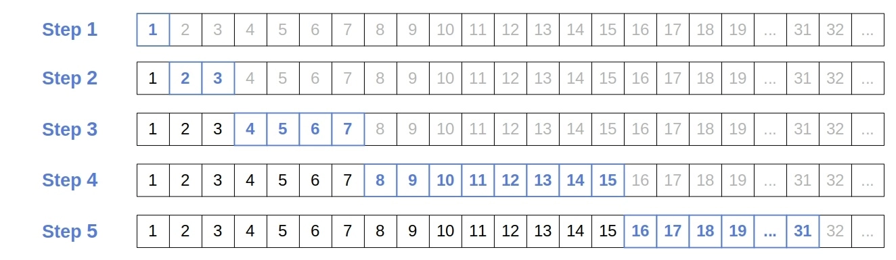
EXPONENTIAL SEARCH
Applications of Exponential Search:
Exponential Binary Search is particularly useful for unbounded searches, where size of array is infinite. Please refer Unbounded Binary Search for an example.
It works better than Binary Search for bounded arrays, and also when the element to be searched is closer to the first element.(Eksponensial Axtarış Tətbiqləri:
Eksponensial İkili Axtarış, massivin ölçüsünün sonsuz olduğu qeyri-məhdud axtarışlar üçün xüsusilə faydalıdır. Nümunə üçün Sərhədsiz Binar Axtarışa baxın.
O, məhdud massivlər üçün Binar Axtarışdan daha yaxşı işləyir, həmçinin axtarılacaq element birinci elementə yaxın olduqda.)

Slide 10
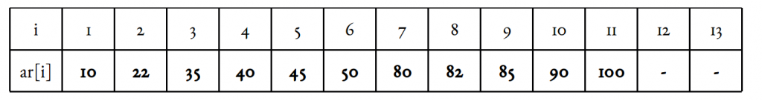
FIBONACCI SEARCH
Given a sorted array arr[] of size n and an element x to be searched in it. Return index of x if it is present in array else return -1(n ölçüsündə çeşidlənmiş massiv arr[] və orada axtarılacaq x elementi verilmişdir. X-in indeksini qaytarın, əgər o massivdə varsa, əks halda -1 qaytarın)
Examples:
Input: arr[] = {2, 3, 4, 10, 40}, x = 10
Output: 3
Element x is present at index 3.
Input: arr[] = {2, 3, 4, 10, 40}, x = 11
Output: -1
Element x is not present.

Slide 11
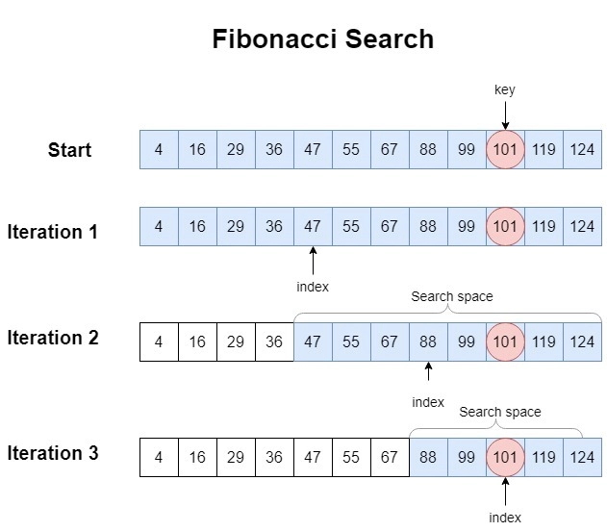
Timeline

Slide 12
Areas of focus
B2B market scenarios
Cloud-based opportunities
Develop winning strategies to keep ahead of the competition
Capitalize on low-hanging fruit to identify a ballpark value
Visualize customer directed convergence
Iterative approaches to corporate strategy
Establish a management framework from the inside

Slide 13
How we get there
ROI
Niche Markets
Supply chains
Envision multimedia-based expertise and cross-media growth strategies
Visualize quality intellectual capital
Engage worldwide methodologies with web-enabled technologies
Pursue scalable customer service through sustainable strategies
Engage top-line web services with cutting-edge deliverables
Cultivate one-to-one customer service with robust ideas
Maximize timely deliverables for real-time schemas

Slide 14
Summary
At Contoso, we believe in giving 110%. By using our next-generation data architecture, we help organizations virtually manage agile workflows. We thrive because of our market knowledge and great team behind our product. As our CEO says, "Efficiencies will come from proactively transforming how we do business."

Slide 15
Thank you
Mirjam Nilsson​
mirjam@contoso.com
www.contoso.com

